Slide 1
Ilista A MADT 6123 Project
Dogukan Karayilanoglu C0755495
Rosette Lopez Pardillo C0768425

Slide 2
ILISTA PROJECT ASSETS
GITHUB
Repository contains Source Code, Video Demo & PPTX
https://github.com/otetLopez/ilista6123.git
PPT
Aside from committed in GITHUB Repo in link above, pptx is also uploaded in dropbox
VIDEO
Aside from committed in GITHUB Repo in link above, video demo is also uploaded in dropbox
This Photo by Unknown Author is licensed under CC BY-SA
This Photo by Unknown Author is licensed under CC BY-SA

Slide 3

ILISTA PURPOSE
ILISTA application is a simple note application implemented using react.
There may be several note applications available in Application stores but the sole purpose for this project is to showcase each members learnings on 6123 class
Data user has saved into Ilista note application will be saved into database.
ILISTA has basic features which a note taking app has, as well as saving data to database and will soon be upgraded for the Capstone project

Slide 4
ILISTA DEVELOPMENT Fundamentals
JavaScript Object Programming
React Development
CRUD Functionality
Event Handling
Web and Mobile Support
Database

Slide 5
ILISTA features
Note List Display
The home page, or main page shows all the list of notes created by the logged in user.
Contains the button for adding a new note
Add Note
Logged in user can add new note and enters details of a new note, the title and contents
Update Note
Entered notes can be updated by clicking the title of the note, list in main page will be updated
Delete Note
Entered notes can be deleted, list in main page will be updated

Slide 6
ilista function diagram
Browser/Device
ILISTA
APPLICATION
WEBSERVICE
DATABASE
USER
UI
CONTROLLER

Slide 7
ilista Display Diagram
Browser/Device
ILISTA
APPLICATION
ADD NOTE
USER
MAIN VIEW NOTE LIST
UPDATE NOTE
DELETE NOTE

Slide 8
ilista Database design
Notes
 | note_title
 | note_detail
PK | note_id
Ilista database will have 1 main table:
Note – will contain all notes created by the user

Slide 9
ilista Entity relationship diagram

Slide 10
ILISTA DAtabase
PATH
It is stored in root Ilista project folder with filename ilista.db
DB
Database is implemented using SqLite3
EXPRESS
DB is accessed using Express JS

Slide 11
ILISTA accessing DB
ILISTA makes sure you get to most updated data from there server. It requests for data from the database before it renders the lists of notes.
When a note is update, modifications are sent immediately to database
When a note is to be deleted, it will be deleted in the database.

Slide 12
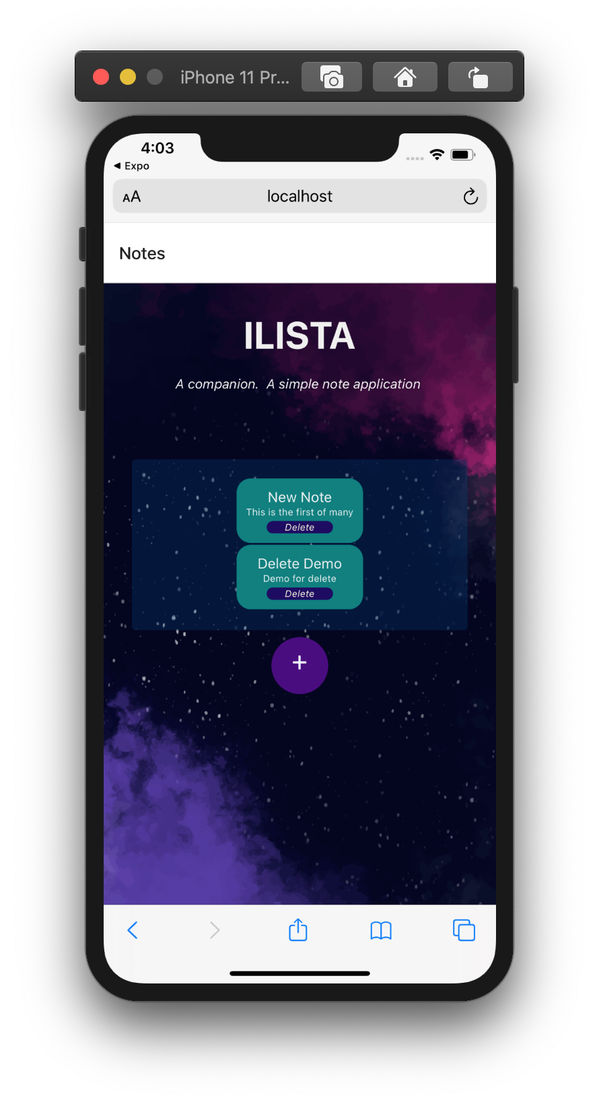
ILISTA Note List display Page
This is the default view of the application. The following image shows ILISTA ran in an Iphone XSMax. In this screenshot, a single note has already been created by the user with tithe “This is a new note”

Slide 13
ILISTA ADD NOTE
When the ADD button from Note Display is clicked, the Add Note UI is Stack screen is shown, allowing user add a new note and input its details

Slide 14
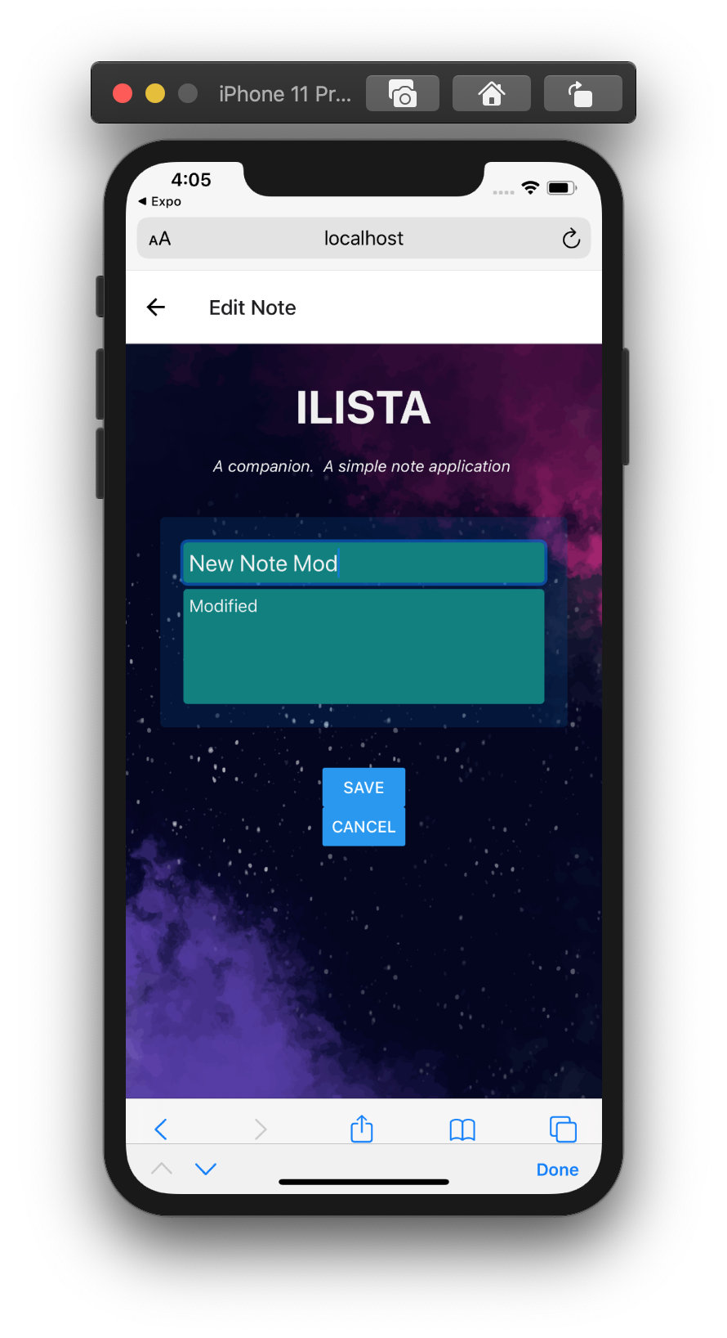
ILISTA UPDATE NOTE
When the title of an existing note is clicked, it allows user to modify existing notes and change the title and details. Once changing is done, user taps the Save button to confirm update is finished.

Slide 15
ILISTA Delete NOTE
In the Note List View, there is a button that allows the user to delete a note. The images shows before the 2nd and 3rd notes are deleted(left) and after the delete button is clicked (right)

Slide 16
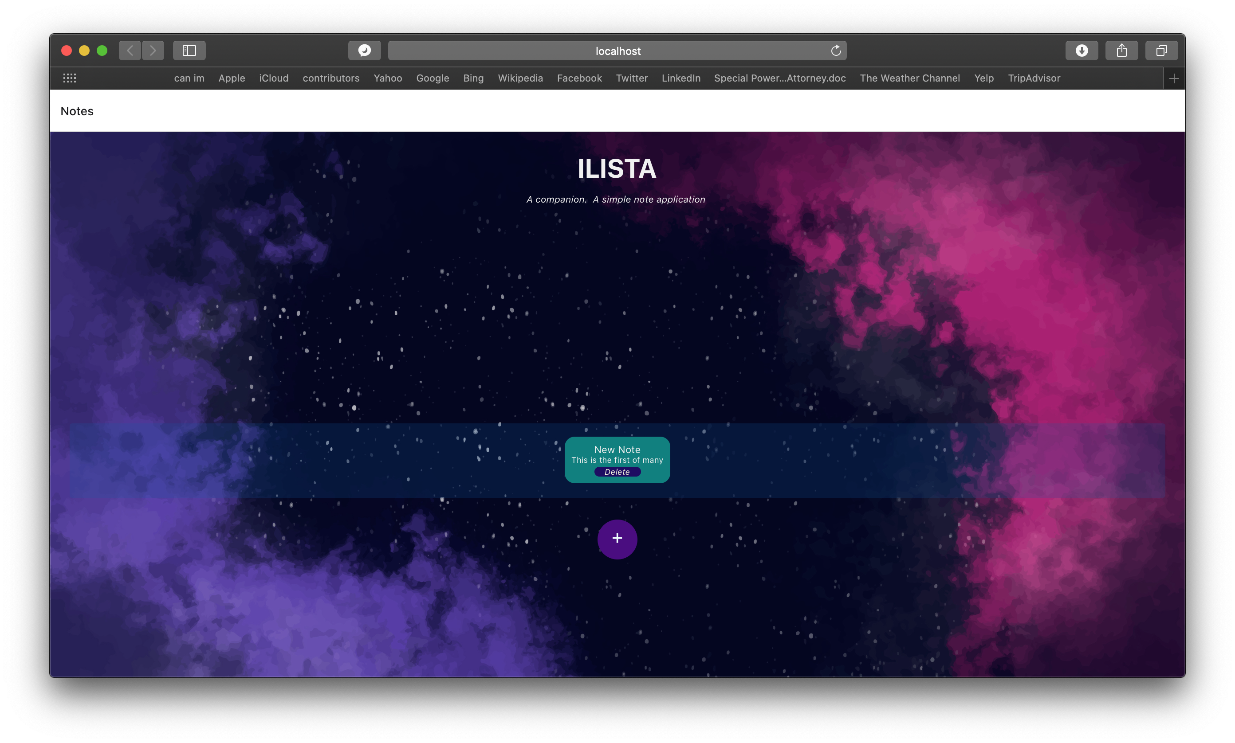
ILISTA Web application
This is how ILISTA looks in web browser

Slide 17
ILISTA running the application
RUN EXPRESS SERVER
Navigate to Ilista project in any terminal/command line.
$ cd src
$ node Server.js
RUN ILISTA APPLICATION
This application is expo based and can run in web, ios, and android
Navigate to Ilista project in any terminal/command line
$ expo start

Slide 18
ILISTA FUTure implementations
Multiple user update
Group of user should be able to update a note depending on whom it is shared to
Time Information
Save Time the user created the note and support reminder functionality
Mobile Hardware
Use of camera, location, mic and speaker

Slide 19
Live Long & Prosper

